Slide 1

Data Analysis with Python Part 1

Slide 2
Camera Expectations

Slide 3



Before we start… Please have your camera switched on.
Camera Expectations
This is a mandatory requirement for the duration of the course.
You are studying a regulated qualification, your tutor needs to see that it is the right person participating throughout the course.
Our job is to prepare you for work in an age where in almost any job there is likely to be at least some aspect of remote engagement with your employer.
Online learning is to be treated the same way as a classroom learning, you must be physically visible to interact with your tutor and other learners in order to create an engaging group dynamic.

Slide 4


Background filters
If you do not wish to have your camera displaying your personal environment, Microsoft Teams has a solution to this problem…
Step One: Before you join a Teams video call, click the ‘Background Filters’ option.
Step Two: On the right-hand side, you can select any of the stock images.
Step Three: The image you choose will then appear in your background on the video call.
If you need any further support in regards to this requirement, please speak to your tutor directly.

Slide 5
Objectives
What is Pandas?
Pandas DataFrame
Datasets Importation
Data Exploration, Selection, and Filtering

Slide 6

Pandas
Bootcamp
Pandas is a Python library for working with datasets
Easy for handling large amount of data
It has functions for analysing, cleaning, exploring, and manipulating data
Created by software developer Wes McKinney in 2008
Short video about the author: https://www.youtube.com/watch?v=pqMu18dmEdM
Notes:
Official summary: https://www.python.org/doc/essays/blurb/
Image source: https://www.python.org/static/img/python-logo@2x.png

Slide 7
Pandas data structures
Series
(1D like array)
Dataframe
(2D like array or more)
columns index
0
1
Country
United Kingdom
France
Mexico
Canada
Country | Population
United Kingdom | 68521968
France | 65273511
Mexico | 128932753
Canada | 37742154
0
1
2
3
0
1
2
3
rows index
rows index
Command to create a Serie:
pd.Series( )
Command to create a dataframe:
pd.DataFrame( )
Notes:
Pandas has 2 data structures: Series and Dataframe
Your dataset will be read as a DataFrame which is a 2 dimensional data structure, like a 2 dimensional array, or a table with rows and columns
A Pandas Series is like a column in a table. It is a one-dimensional array holding data of any type

Slide 8
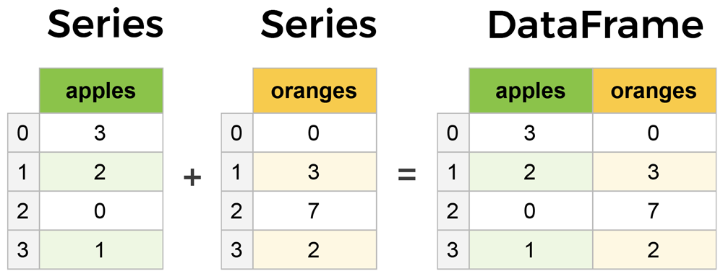
Pandas Series
Notes:
Source link: https://www.learndatasci.com/tutorials/python-pandas-tutorial-complete-introduction-for-beginners/

Slide 9
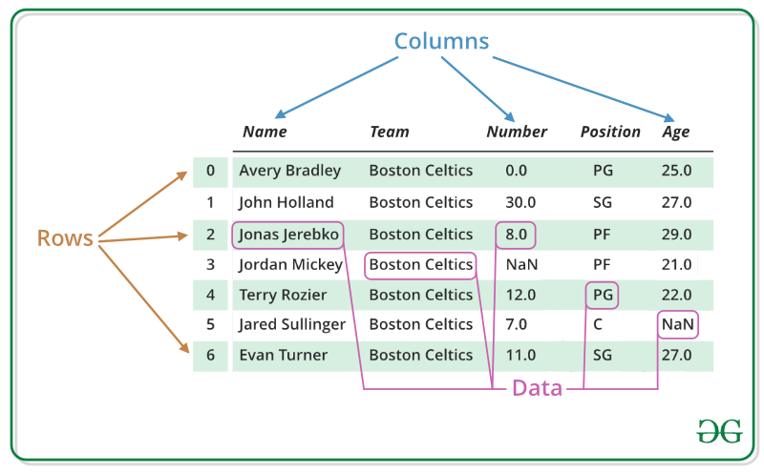
Understanding DataFrame
Bootcamp
Source link: https://www.geeksforgeeks.org/python-pandas-series/
Notes:
Source link: https://www.geeksforgeeks.org/python-pandas-series/

Slide 10

Jupyter notebook Script
Follow along with your Instructor using the Jupyter notebook script named pandas-script_part1.ipynb

Slide 11
Series creation
From a list [ ]:
From a dictionary { }:
1-Create a list:
list_countries= ['United Kingdom', 'France', 'Mexico', 'Canada’]
2-Pass the list in the pandas series function:
pd.Series (data=list_countries)
1-Create a dictionary:
dic_pop= {'United Kingdom':68521968, 'France':65273511, 'Mexico':128932753, 'Canada':37742154}
2-Pass the dictionary in the pandas series function:
pd.Series (dic_pop)
output
output

Slide 12
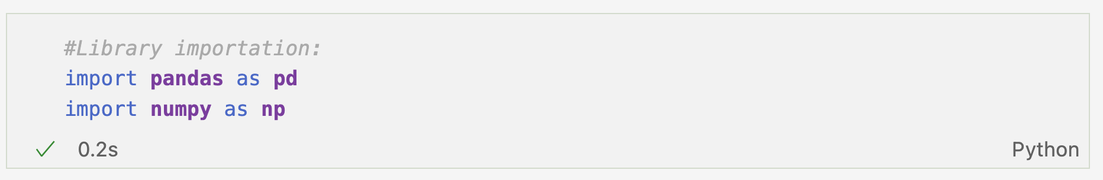
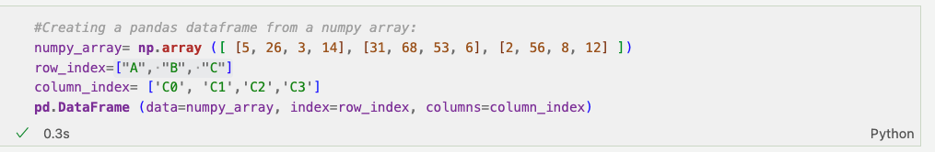
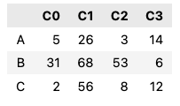
Creating a pandas dataframe
output
Parameters: used in functions/methods (data, index, columns etc. )
Attributes: gives information about the data
Methods: functions that transform the data

Slide 13

Data importation
1-Upload the dataset datacensus.csv in Google Colab
2- Create a new variable to store your dataframe and pass the variable that contains your file path in the following command:
dataframe= pd.read_csv (‘datacensus.csv’)
3-Call the variable name to display the dataset:
dataframe
Commands to read a CSV or Excel file:
pd.read_csv()
pd.read_excel()

Slide 14
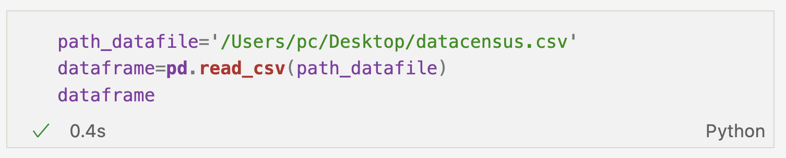
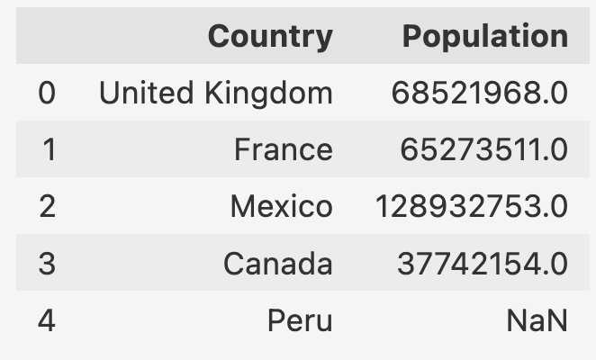
Data importation (cont.)
output
Missing value:
Not A Number

Slide 15
Data exploration
.head() method
The attribute shape give
the total numbers of
rows and columns:
dataframe.shape
Explore the 5 first
rows:
dataframe.head()
output
.tail() method
(27, 2)
Explore the 5 last
rows:
dataframe.tail()
27 rows and 2 columns
Try:
dataframe.head (10)
dataframe.tail (22)

Slide 16
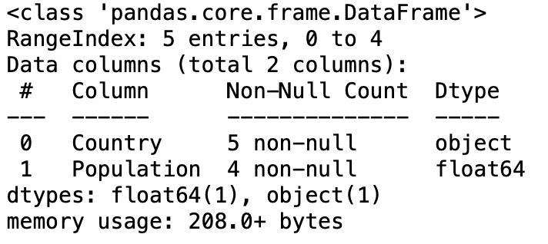
Data exploration cont.
Get a quick summary of the dataframe with the .info() method (i.e. # of columns and rows,
data type, missing values #): dataframe.info()
Country | Population
United Kingdom | 68521968
France | 65273511
Mexico | 128932753
Canada | 37742154
Peru | NaN
0
1
2
3
4
output
missing value

Slide 17
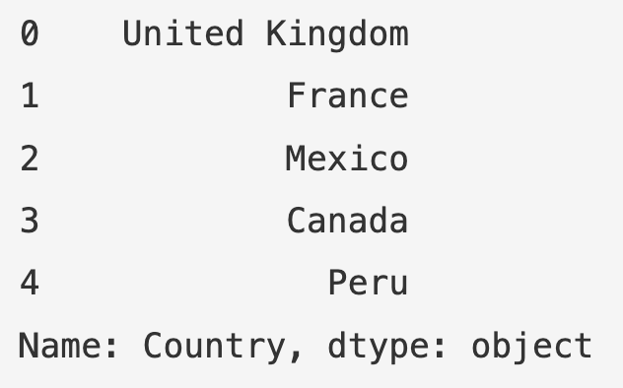
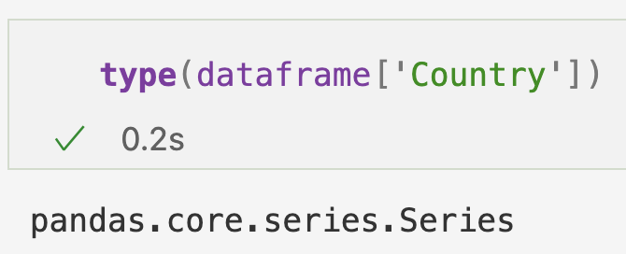
Data selection (columns)
Select one column
by column name using
double backets [[ ]]:
dataframe[['Country']]
Country | Population
United Kingdom | 68521968
France | 65273511
Mexico | 128932753
Canada | 37742154
Peru | 32971854
Select more than one
column:
dataframe[['Country', 'Population']]
0
1
2
3
4
The new column can be stored in a new variable:
countries=dataframe
[['Country']]
It is possible to select data with one pair of [ ], but python will return a Series object not a dataframe: try dataframe['Country']
The method type() gives the data type
Notes:
Other way to select columns: dataframe.Country

Slide 18
Data selection (rows)
.loc and .iloc commands
dataframe.loc[0, 'Country']
Country | Population
United Kingdom | 68521968
France | 65273511
Mexico | 128932753
Canada | 37742154
Peru | 32971854
0
1
2
3
4
dataframe.iloc[2,1]
.loc
(primarily label based)
loc[row label, column label]
.iloc
(integer based)
iloc[row position, column position]

Slide 19
Data selection (rows cont.)
.loc and .iloc commands
Country | Population
United Kingdom | 68521968
France | 65273511
Mexico | 128932753
Canada | 37742154
Peru | 32971854
It is possible to select/slice a part of the dataframe using a colon or/and a comma
Try:
dataframe.iloc[0:3]
dataframe.iloc[0:3, 0:1]
dataframe.loc[0]
OR
dataframe.iloc[0]
0
1
2
3
4
dataframe.loc[2:4]
dataframe.iloc[2:4]
It selects the first row index to n-1

Slide 20
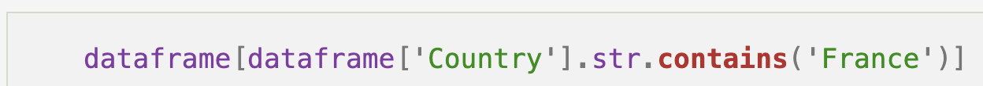
Data selection (pattern)
.str.contains() method is used to search for a particular string pattern:
dataframe['Country'].str.contains('France')
1-The function evaluate each rows on the Country column for the presence of the string 'France'. If there is no match, it returns False, if there is a match it returns True.
2-The function returns a pandas series object of Boolean values.
3-Selecting the previous command with dataframe[] will return all data related to the string 'France'.

Slide 21
Data manipulation
Rename a column name:
.rename(columns={'previous name': 'new name’})
dataframe.rename(columns={'Country': 'COUNTRY'})
Reassign a new row index:
new_index=['UK','FR','MX','CA','PR']
new_dataframe= dataframe.copy()
new_dataframe.index=new_index
To not erase the initial dataframe, we can create a copy so the change of index will affect only the copy not the original dataframe

Slide 22
Data manipulation
Drop one column:
dataframe.drop('Population', axis=1)
axis=1
Drop one row:
dataframe.drop(4, axis=0)
axis=0
default axis
axis=0 corresponds to the rows
axis=1 corresponds to the columns

Slide 23
Data manipulation
.str.replace('old value', 'new value')
dataframe['Country'].str.replace('United Kingdom', 'UK')

Slide 24
Handling missing data
Depending on your initial problem, you might want to replace missing values by a zero value, a median/mode of the column or removing them.
.fillna() function is used to replace missing values:
Country | Population
United Kingdom | 68521968
France | 65273511
Mexico | 128932753
Canada | 37742154
Peru | NaN
0
1
2
3
4
NaN: Not A Number
dataframe['Population']=dataframe['Population'].fillna(0)
can be any numerical value
Notes:
NaN floating point that cannot be converted
all dataset: dataframe=dataframe.fillna(0)

Slide 25
Checking Missing Values
Check if there are missing values in any rows:
df.isnull().values.any(axis=1)
Check total missing values in each column:
df.isnull().sum()
Check total missing values in dataframe:
df.isnull().sum().sum()

Slide 26
Data cleaning
Checks:
Remove missing values (NaN) from the dataset
Value replacement: perform the average of other values or using the mode
Check info(): it will give you the count of non-null values, hence null values present in the dataset (null values in pandas are missing values which corresponds to empty rows with no data)
Data uniformity: change type of data/rename variables names
Detect missing values: isnull() function
Drop unnecessary columns with drop() function
Transform your numbers: absolute number
Remove outliers (can be seen when plotting the data using a box plot )
lead to make proper analyses
Notes:
NaN floating point that cannot be converted

Slide 27
Task 1
Use the sales.csv file, to answer the following questions. You may need to look at the Pandas documentation to help you.
Import the Sales data
Display the information about the dataframe
Check if there are missing values and if they need to be cleaned out
Set the first two columns as index (do some research to know how to do that)
Display first 3 land last 3 rows of the sales dataframe
Display the statistical information about the dataframe
Display the sales column as a series
Display sales and profit column as a dataframe
Display the data for Southern Asia
Display Sales and Profit data for Western Africa, Southern Africa, and North Africa
Display Markets with Sales above 300,000
Notes:
Answers
102 Since the lists have the details of all the products, you can find the number of products sold by calculating the number of elements in the list. Syntax: number.size [For this command, the list has to be converted into an array first]
409 The total number of items sold for each product will be the sum of the elements in the list ‘number’. Syntax: number.sum() [For this command, the list has to be converted to an array first.]
139 The average price of products will be the mean of the elements in the list ‘price’. Syntax: price.mean() [For this command, the list has to be converted to array first]
285 The maximum value in the list ‘price’ will give you the price of the costliest product. Syntax: max(price) [You can use the command over a list or an array directly.]
67,100 The revenue of the company will be the sum of (price * quantity) for each product sold. Syntax: np.sum(price*number) [For this command, the lists have to be converted to array first.]
True This can be checked through the conditional operator. Syntax: number[19]>number[49]
52 You can subset the required entries and then take a count of them. Syntax: price[price > price.mean()].size [For this command, the list has to be converted to an array first]

Slide 28
Data Analysis with Python Part 2

Slide 29
Objectives
How to filter data using conditions
How to perform calculations
Grouping data
JSON data

Slide 30
Jupyter notebook Script
Follow along with your Instructor using the Jupyter notebook script named pandas-script_part2.ipynb

Slide 31
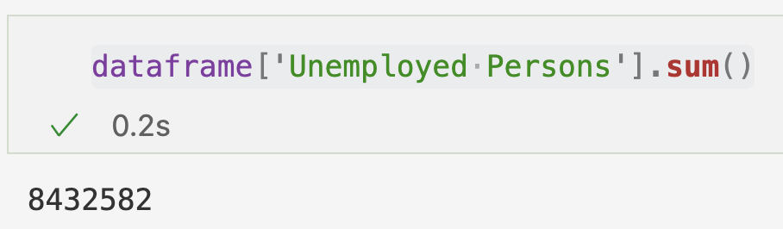
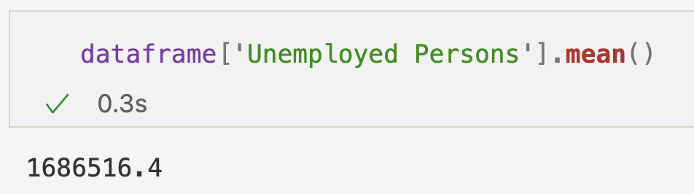
Data manipulation
Operations
Import the file datacensus2.csv
.sum() method
.mean() method
*Number of people registered as unemployed on Feb 2022 (might not reflect true number)

Slide 32
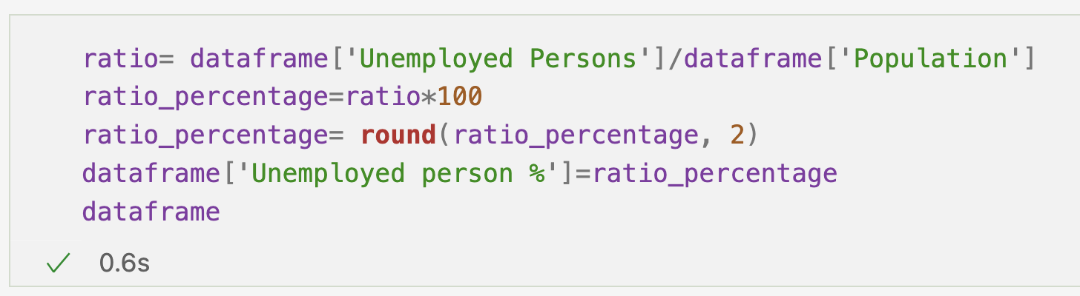
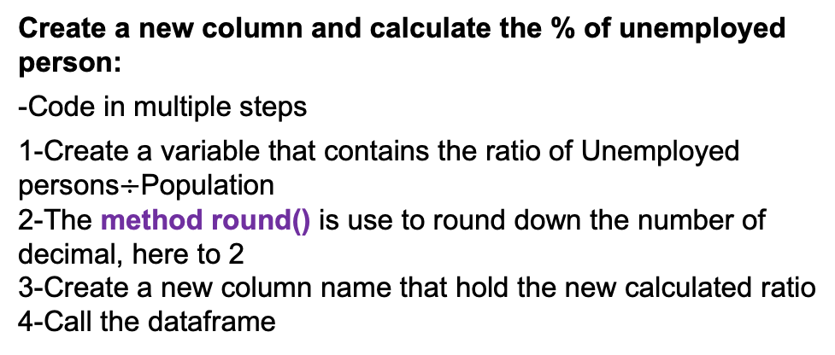
Data manipulation
Operations cont.
Create a new column and calculate the % of unemployed person:
-Code in multiple steps
1-Create a variable that contains the ratio of Unemployed persons$÷$Population
2-The method round() is use to round down the number of decimal, here to 2
3-Create a new column name that hold the new calculated ratio
4-Call the dataframe
Save your new dataframe on your desktop:
dataframe.to_csv('path/filename.csv')

Slide 33
Data manipulation
Data filtering using boolean indexing
Use the following operators to test conditions:
<, >, ==, >=, <= , & (and), | (or), ~ (not)
Let’s filter the data and keep countries with population size > 100 million: dataframe['Population']>100000000
Encompassing the previous command with dataframe[ ] will return the true condition in a pandas dataframe:
dataframe[dataframe['Population']>100000000]
Pandas Series output
Notes:
#If we want to filter the data by keeping only data in the UK:
dataframe[dataframe['Country']=="United Kingdom"]

Slide 34
Data manipulation
Data filtering using boolean indexing cont.
Let’s filter the data based on two conditions:
(dataframe['Country']=="Mexico") & (dataframe['Population']==128932753)
Encompassing the previous command with dataframe[ ] will return the true condition in a pandas dataframe:
dataframe[(dataframe['Country']=="Mexico") & (dataframe['Population']==128932753)]

Slide 35
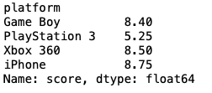
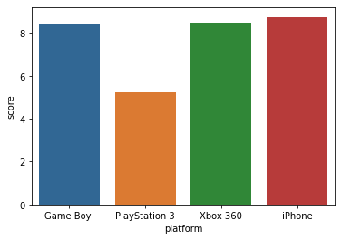
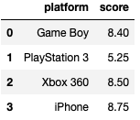

Data manipulation
Grouping data with groupby()
return a pandas series
Import the videogames.csv file with the pandas library
dataframe.groupby("platform")["score"].mean()
Use the parameter as_index=False in the groupby()
function to return a pandas dataframe:
dataframe.groupby("platform",as_index=False)["score"].mean()
Import visualisation library seaborn:
import seaborn as sns
sns.barplot(data=dataframe, x='platform', y='score')
Notes:
groupby documentation: https://pandas.pydata.org/docs/reference/api/pandas.DataFrame.groupby.html

Slide 36
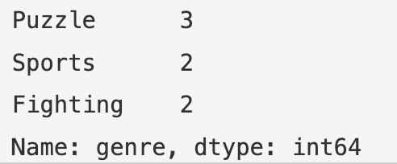
Data exploration
How to Count unique values:
dataframe["genre"].value_counts()

Slide 37
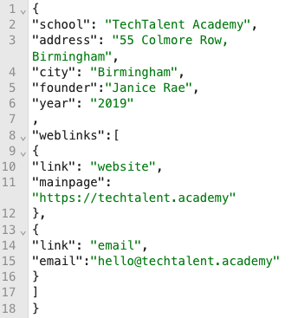
Working with JSON data
JSON data:
Text format derived from JavaScript (JavaScript Object Notation).
JSON syntax is similar to python dictionaries with {key : value} pairs, and python arrays []
Example of JSON object
Examples of JSON string
Example of JSON array

Slide 38
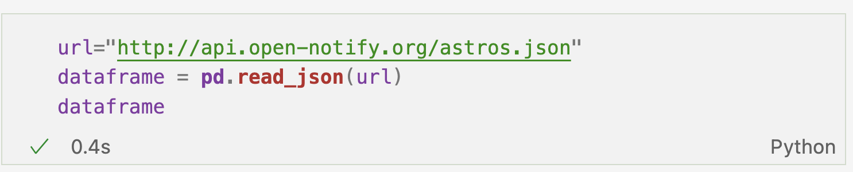
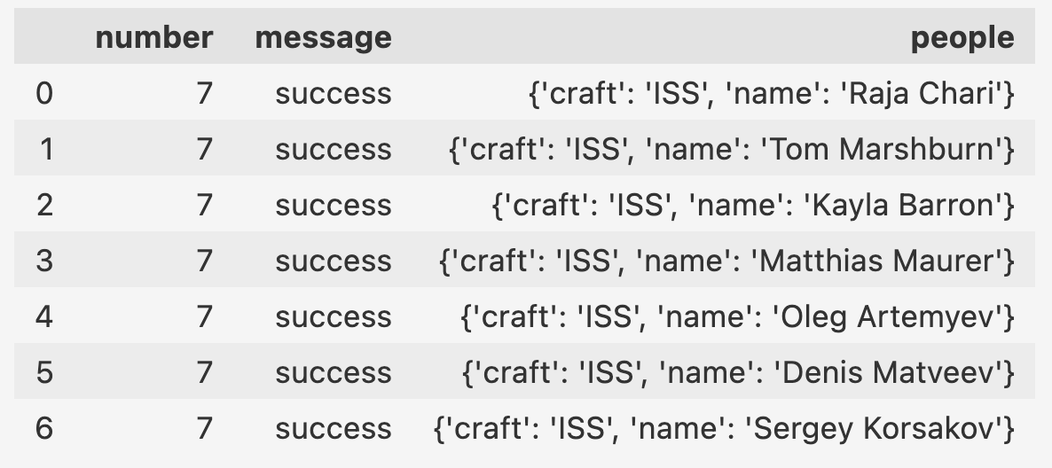
Working with JSON data
nested JSON data
needs to be flatten
Import JSON data from an url:
output
Current astronauts in space JSON data:
http://api.open-notify.org/astros.json

Slide 39
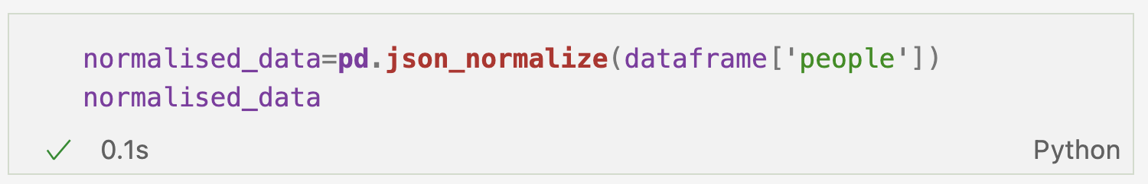
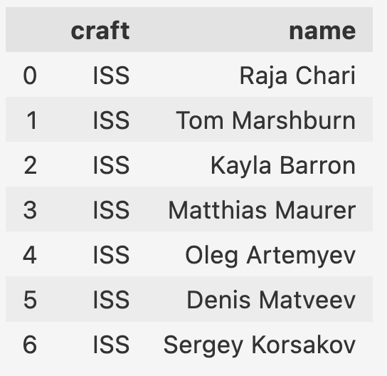
Working with JSON data
How to work with nested JSON data:
pd.json_normalize data() function will flatten the nested JSON data from the columns 'people'
It is common that JSON data will be more complex and have nested dictionaries that need to be flatten

Slide 40
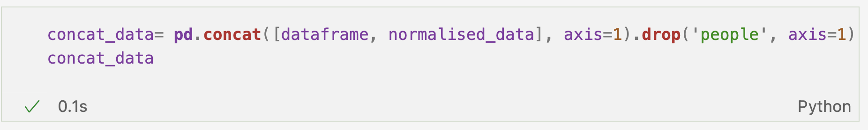
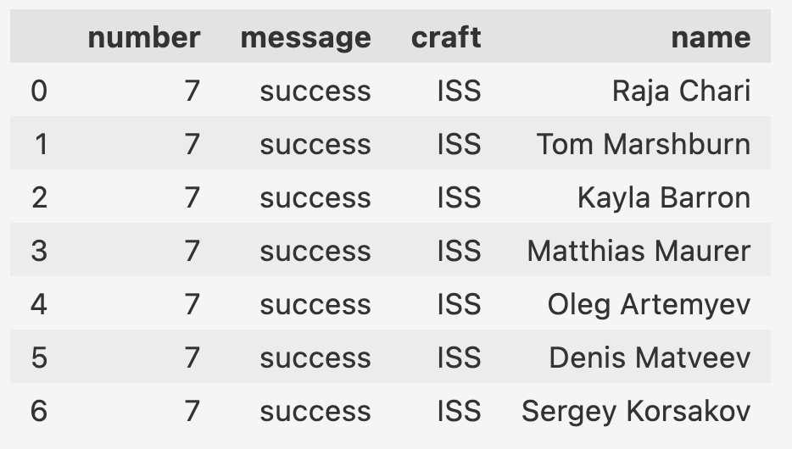
Working with JSON data
How to work with nested JSON data (cont.):
The previous flatten JSON data needs to be added to the previous JSON data.
To combine dataframes: pd.concat() allows the concatenation of 2 or more dataframes, and the previous column 'people' is dropped with the function drop() as we saw in session 1

Slide 41



Data importation from APIs
Application Programming Interface (API):
APIs can be used to access/store/delete information/data
HTTP request methods are used to access or modify data from database via an API
HTTP request method sent
(data: GET, POST, PUT, DELETE)
HTTP response
(data: JSON, XML, pictures, audio, videos etc.)
Interface communication
on the web
database
Notes:
HTTP: Hypertext Transfer Protocol

Slide 42
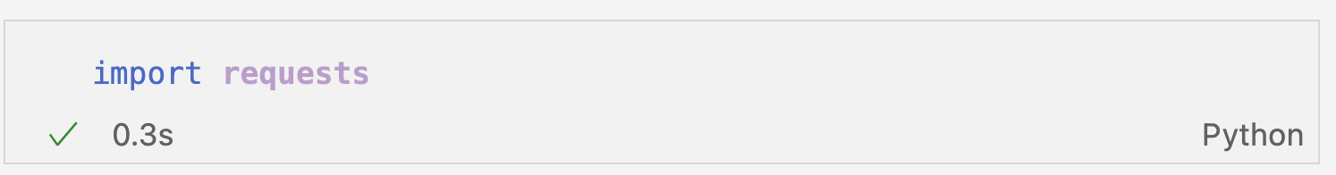
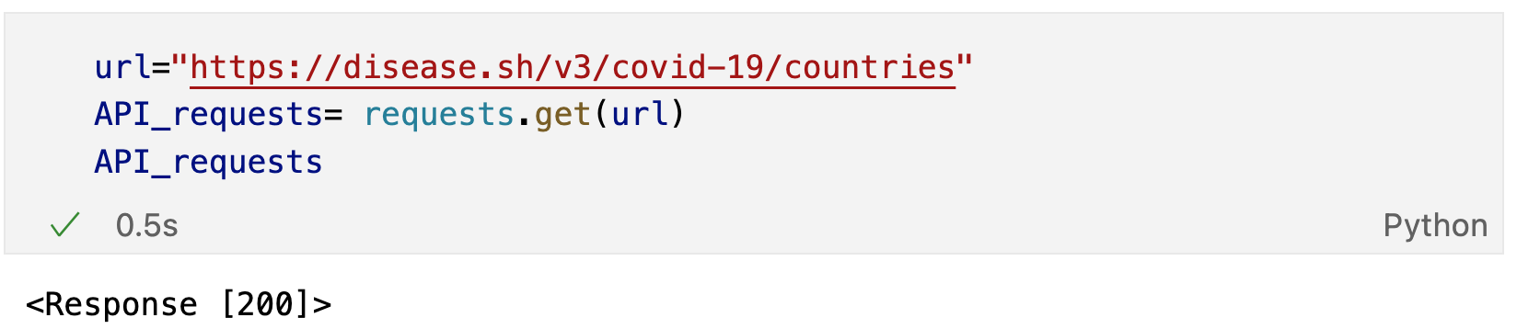
Data importation from an API
First, we need to import the request module to make an HTTP request in VS Code:
The request method is used to send HTTP requests to get data from an url: requests.get()
(API calling from the following website: https://disease.sh/v3/covid-19/countries)
Output: HTTP response status.
200 means it’s a successful response
Source API website: https://disease.sh/docs/
Notes:
https://disease.sh/docs/

Slide 43
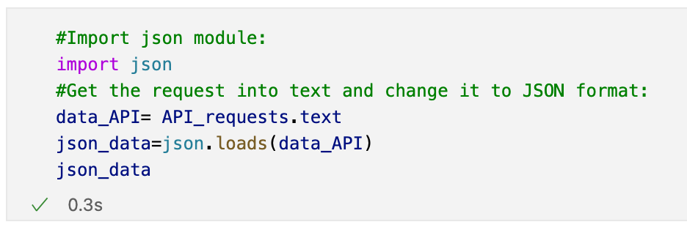
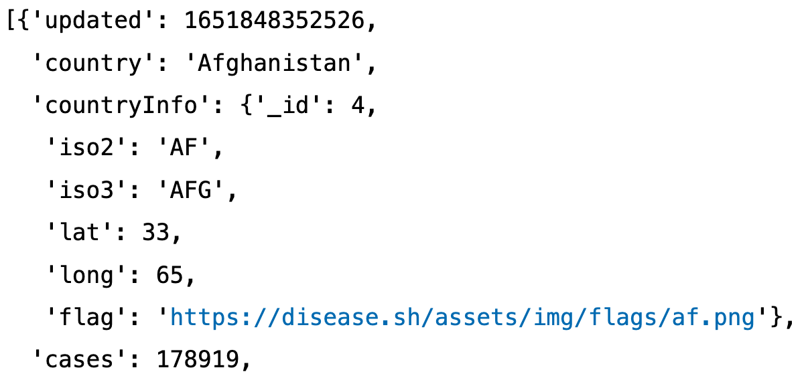
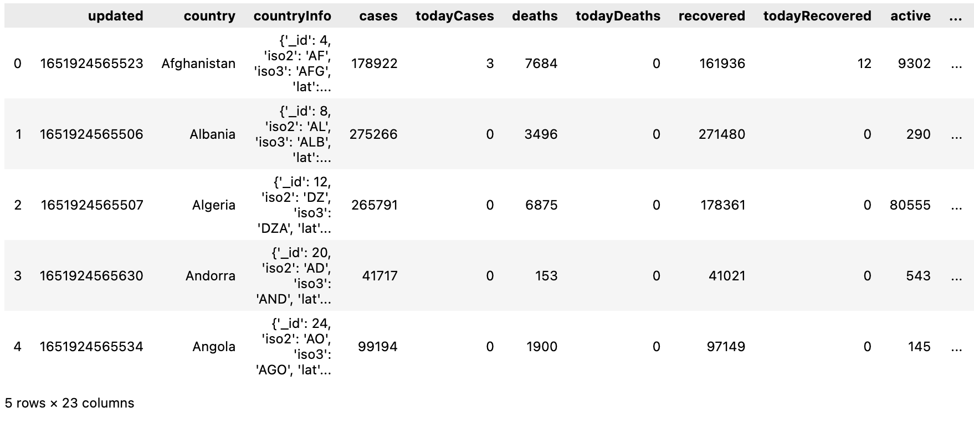
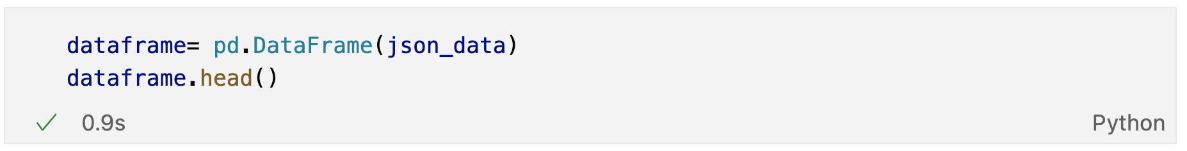
Data importation from an API (cont.)
The JSON library needs to be imported to work with JSON data.
The get request needs to be converted into text and then loaded into a JSON format:
output
We can transform the JSON data into a pandas dataframe:
output
Notes:
https://disease.sh/docs/

Slide 44

Practice Exercise- Task2
You have been given a dataset to analyse which requires some cleaning.
Part .1
Import the file named Data_Analyst_Sample.csv in Pandas
Explore the file with at least 3 common exploration methods in Pandas
How many rows and columns the data file has?
Which column names have missing values and how many?
Remove missing values from columns that contain Pandas object datatype
Replace missing values by zero in columns that contain numbers
Verify that no missing values are in the data file
Part 2
Open the “errors.csv” file with Excel to check the errors associated to the “Campaign name”.
Correct the errors that appear in the Data_Analyst_Sample.csv imported with the Pandas into a Python script:
Count how many errors there are in the dataset (you might want to use a loop for this and using the .contains() method to find the errors)
Use the .replace() method to correct the errors. Verify the errors have been corrected
Example of a technical interview question!
Notes:
Answers
102 Since the lists have the details of all the products, you can find the number of products sold by calculating the number of elements in the list. Syntax: number.size [For this command, the list has to be converted into an array first]
409 The total number of items sold for each product will be the sum of the elements in the list ‘number’. Syntax: number.sum() [For this command, the list has to be converted to an array first.]
139 The average price of products will be the mean of the elements in the list ‘price’. Syntax: price.mean() [For this command, the list has to be converted to array first]
285 The maximum value in the list ‘price’ will give you the price of the costliest product. Syntax: max(price) [You can use the command over a list or an array directly.]
67,100 The revenue of the company will be the sum of (price * quantity) for each product sold. Syntax: np.sum(price*number) [For this command, the lists have to be converted to array first.]
True This can be checked through the conditional operator. Syntax: number[19]>number[49]
52 You can subset the required entries and then take a count of them. Syntax: price[price > price.mean()].size [For this command, the list has to be converted to an array first]

Slide 45
Data Analysis with Python Part 3

Slide 46
PYTHON EDA ~2.5 hrs
You will follow along with your instructor a complete Exploratory Data Analysis (EDA) with PYTHON answering key questions using a variety of libraries to perform data viz. Open the following Jupyter notebook file: https://colab.research.google.com/drive/1ZcD1RbeZd16-q5DXhSsDZlREiA8TXzsW?usp=sharing

Slide 47
Task 3-4 hrs
Group activities in breakrooms:
-Choose a dataset of your choice and preform a similar EDA using python answering some key questions with plots (don’t choose a dataset with too many columns): https://www.kaggle.com
-Work as a group choosing the same dataset, determine some questions to reply with plots as a group!

